Slide 1
Theorists Overview

Slide 2
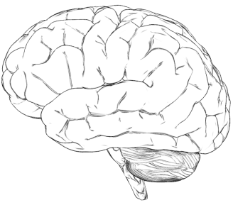
Frames of Mind : Gardner’s Theory of Multiple Intelligences
*Gardner said that multiple intelligences were not limited *
http://mset.rst2.edu/portfolios/t/thoman_j/toolsvis/mapplerproject/brain.html
Intelligence type | Capability and perception
Linguistic | words and language
Logical-Mathematical | logic and numbers
Musical | music, sound, rhythm
Bodily-Kinesthetic | body movement control
Spatial-Visual | images and space
Interpersonal | other people's feelings
Intrapersonal | self-awareness
Intelligence type | Capability and perception
Naturalist | natural environment
Spiritual/Existential | religion and 'ultimate issues'
Moral | ethics, humanity, value of life
N
E
W
http://www.businessballs.com/howardgardnermultipleintelligences.htm

Slide 3
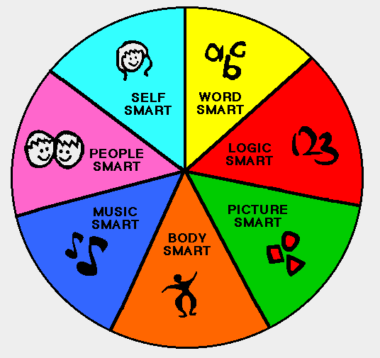
Gardner’s Theory of Multiple Intelligences cont.
Self Smart = Intrapersonal
Word Smart = Linguistic
Logic Smart = Logical/Mathematical
Picture Smart = Visual/Spatial
Body Smart = Bodily/Kinesthetic
Music Smart = Musical
People Smart = Interpersonal
Outside Smart - Naturalistic
http://www.fafutoys.com/blog/2010/04/28/multiple-intelligence-how-many-do-you-have/

Slide 4
Piaget’s Cognitive Development Theory
http://learnboutlearning.blogspot.com/

Slide 5
Kohlberg’s Moral Development Stages
http://www.usefulcharts.com/psychology/kohlberg-stages-of-moral-development.html

Slide 6
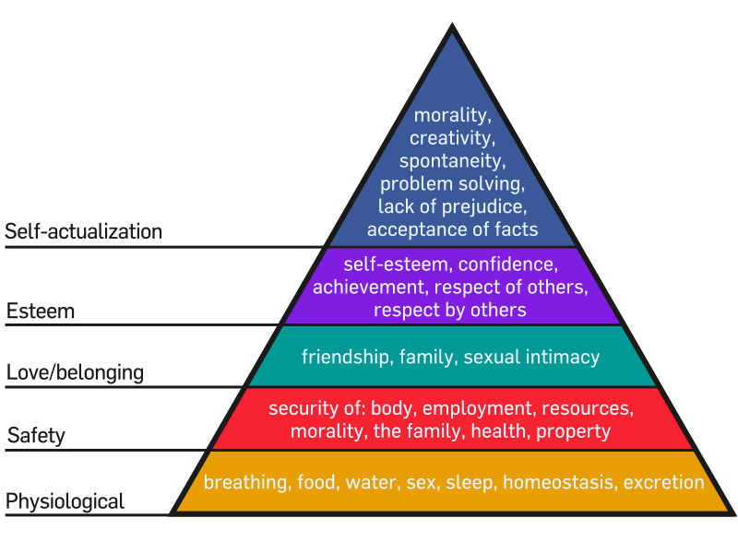
Maslow's Hierarchy of Needs
Social/

Slide 7
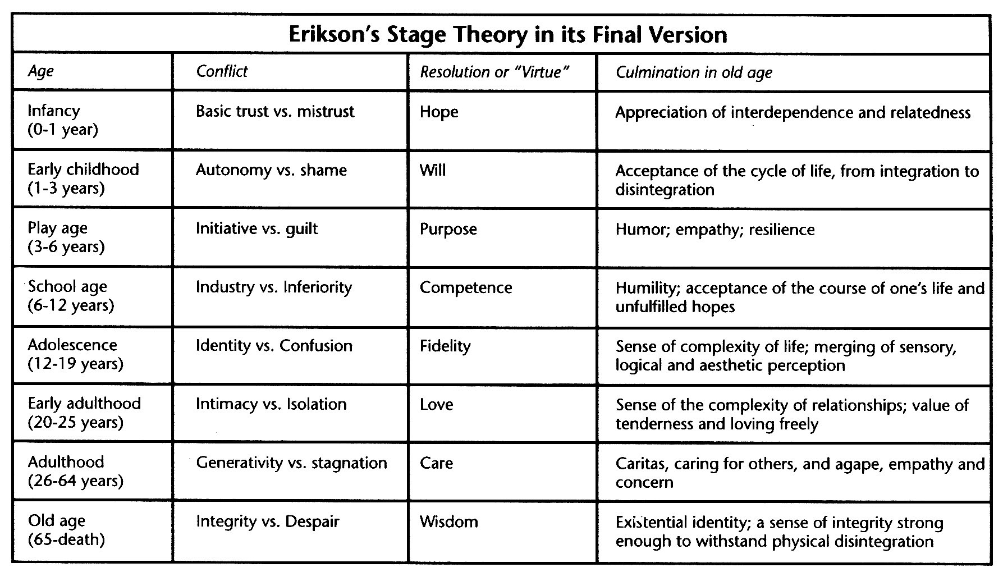
Erikson’s Eight Developmental Stages

